Slide 1
Value of one click?

Slide 2


$100 M
Ask these companies
$79 M
Personal Identity frauds
National Security
Remember John Podesta?

Slide 3
Importance of Protection
To detect phishy emails accurately
Accuracy is the key in detection High accuracy = less chances of fraudulent activity.
It takes just one moment of negligence for disaster to happen

Slide 4
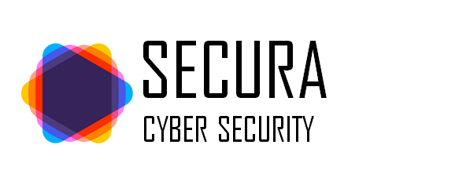
Competition high accuracy of 99.8%
Rated best at ‘fishing’ out phishing mails

Slide 5

Who sends Phishy emails?
$0
ACTUALS
($100M) * 4/1966 = ($0.2M)
FALSE
TRUE
7,111
4
FALSE
PREDICTIONS
923
1,962
TRUE
$0
$100M * 1962/1966= $99.94M
With a high accuracy to detect something phishy, cost benefit analysis values our model at $99.74M

Slide 6


How does a PhiSHY email Look?
Manager <manager@fakeco.com>
un-official ID
Generic greeting
Sun 01.20.2022 2:31pm
To me
Sir/Ma’am,
You are required to use this form to update your login information immediately.
Misleading hyperlinks
Buttons with
hyperlinks
Click Here Now!
Unsolicited
Attachments
Unsolicited.pdf.exe
Grammatical/ Spelling
Errors

Slide 7
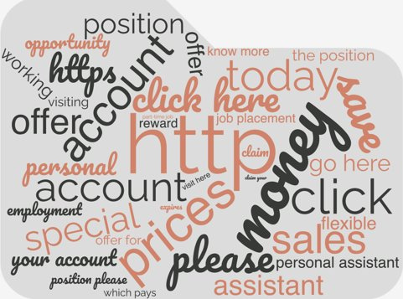
Be careful!

Slide 8




How do we do it?
+
-
+
-
+
-
-
-
+
-
-
+
+
-
-
-
+
+
+
-
+
Email
tokenizer
Word cloud
filter
balance
92%
Probabalistic score

Slide 9
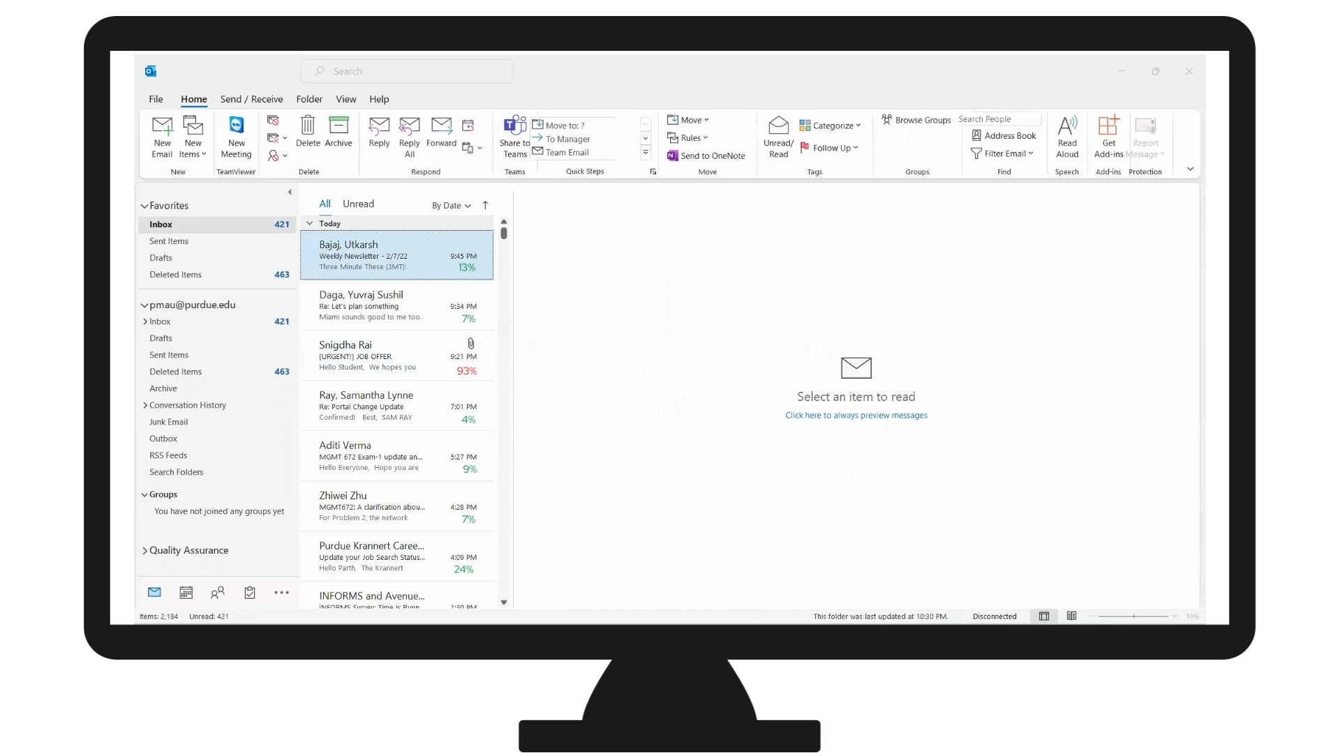

Slide 10
Who is likely to receive A Phishy emails?
Phishing emails make use of emotion to get us to bypass logic
Older women (those aged 62 and older) are more susceptible than any other age group
Younger adults (18-37) are significantly more susceptible to emails that claim scarcity (the limited-time discount, for example)
https://ideas.ted.com/why-we-fall-for-phishing-emails-and-how-we-can-protect-ourselves/

Slide 11
What is the future of Phishing emails?
Understand vulnerability to phishing through anti-phishing training
Internet security experts to tap into the expertise of psychology to prevent cyber-attacks.
Use Reinforcement Learning to retrain and adapt the model with newly identified phishing emails
https://ideas.ted.com/why-we-fall-for-phishing-emails-and-how-we-can-protect-ourselves/

Slide 12
Who sends Phishy emails?
From some source which has some information about you such as where you work, your age, etc. This can make the email more official and genuine
Call centers
Hackers
A secluded king in Nigeria ?
https://ideas.ted.com/why-we-fall-for-phishing-emails-and-how-we-can-protect-ourselves/

Slide 13
Stay Secured with Secura!

